Slide 1
Hands On Adversarial Machine Learning: Building Practical Attacks & Defenses
Dr. Yacin Nadji

Slide 2
Overview
Adversarial ML in a nutshell
Monotonic classification
Retraining w/ adversarial examples
Whitebox attacks
Whitebox defenses

Slide 3
Adversarial ML in a Nutshell

Slide 4
Threat Model
To defend against an adversary, we must understand them
What are their capabilities?
Queryable model vs. model architecture and parameters
No training data vs. read training data vs. write training data
Goals?
Force incorrect classifications (integrity)
Denial of service (availability)
Reverse engineer model and/or parameters (confidentiality)
Complete a patient’s feature vector (privacy)
Attack surface: where am I vulnerable?

Slide 5
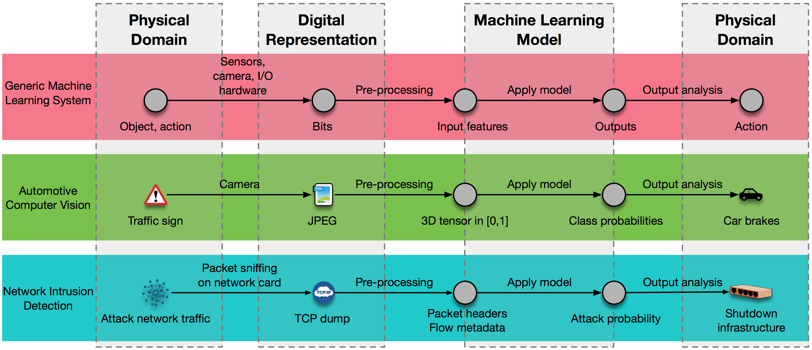
Threat Modeling: Attack Surface
Papernot et al. (2017)

Slide 6
Attacks
Training phase
Inject adversarial inputs, or
Alter the training data
Inference phase
Inputs from outside expected train/test distribution
White box:
Attacker has insider knowledge (e.g., model params, model itself, etc.)
Focus on feature space where model has high error
Black box:
Oracle model from cryptography
More realistic (think MLaaS)

Slide 7
Monotonic Classifiers

Slide 8
Monotonic Classifiers
Stream data, e.g.,
Stream of text data
Stream of system calls
Intuition: Adding additional benign system calls should never make a malicious binary “flip” to benign
Consider negative feature coefficients

Slide 9
Direct Attack
Change a feature vector for a malicious binary such that it is classified as benign. Can you create a function that always successfully “flips” from malicious to benign? Post before-and-after classification results to group chat.

Slide 10
InDirect Attack (Part 1)
Identify terms that are more likely to be associated with benign software than malicious software.

Slide 11
Which of the features below would be a good candidate for abuse? (multiple choice, multiple answers acceptable)
Polling Question
a.) ntwritefile
b.) regcreatekeyex
c.) ntdisplaystring
d.) ntsettimerex
e.) ntreadfile

Slide 12
InDirect Attack (Part 2)
Write a function that alters a malicious program’s call trace so the classifier labels it benign. Describe how your function works. Post before-and-after classification results to group chat for all ground truth cases (use collections.Counter()).

Slide 13
Monotonic Defense
Change the classifier’s coefficient for your abused feature to not be negative. See if your function from the previous exercise still work. Post your findings to group chat.

Slide 14
Retraining w/ Adversarial Examples

Slide 15
Retraining as a Defense
Adversarial examples
Generate
Easy in specific cases
Harder to generalize
Retrain
Easy! If you have examples

Slide 16
Break DGA Classifier
Generate a function that adds additional domain names to confuse the classifier between two DGA families. Post before-and-after classification results. Make use of the pandas.crosstab() (see _cv() function).

Slide 17
FIX DGA Classifier
Using your adversarial examples from the previous exercise, retrain the model and demonstrate it is resistant to your function from the previous exercise. Post relevant confusion matrices to the chat.

Slide 18
cleverhans & Whitebox Attacks

Slide 19
DNN Attacks
Lots of focus on DNNs. Why?
Lots of space for hidden perturbations
Model works directly on input image/audio/etc.
Lots of work: [25, 26, 30, 51, 52, 53, 56, 66, 67]
Very, very good w/ incremental improvements:
Misclassify ~90% of MNIST
4% feature perturbation —> 97% attack success rate
Specific “junk” class doesn’t help [52]
Model output surface poorly understood due to linear extrapolation

Slide 20
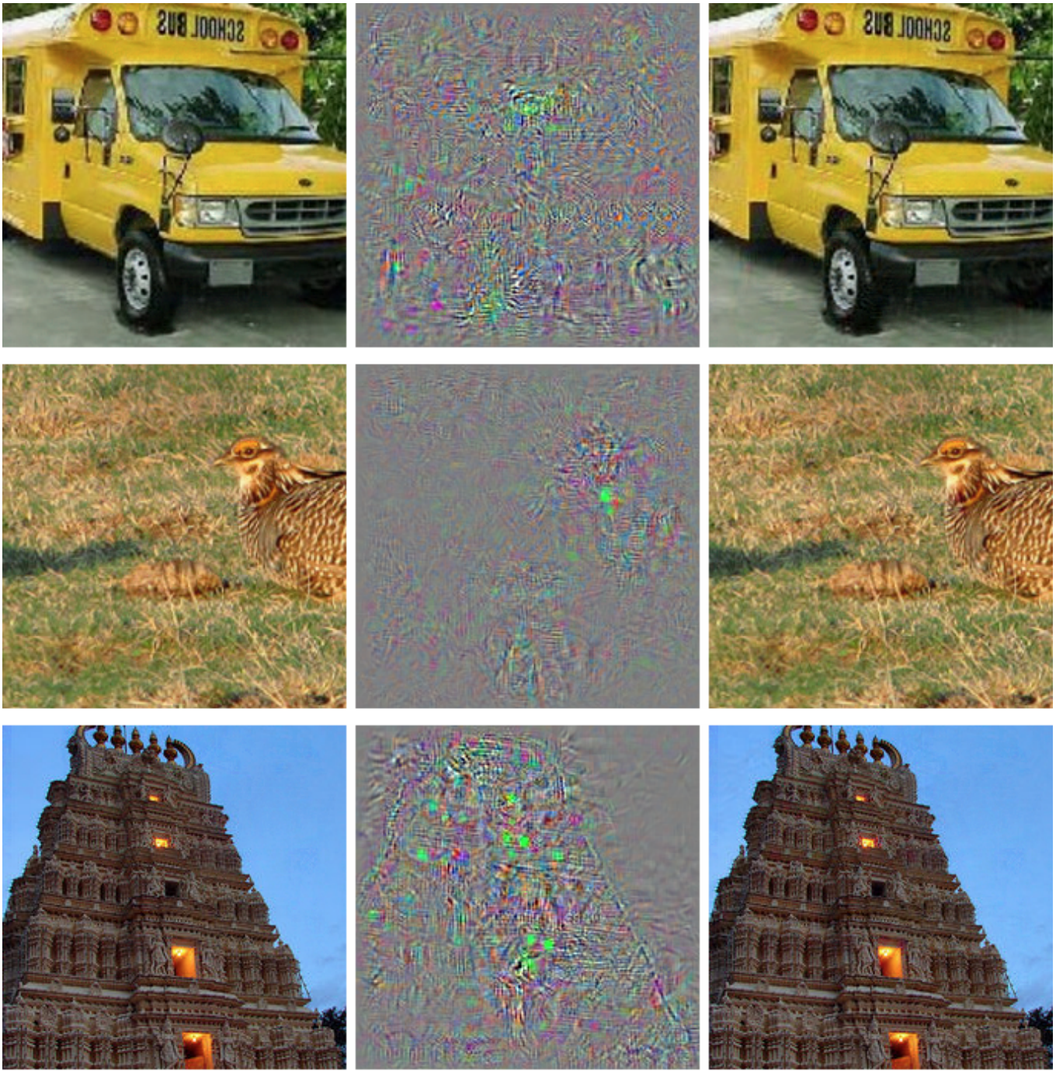
Whitebox (Direct)

Slide 21
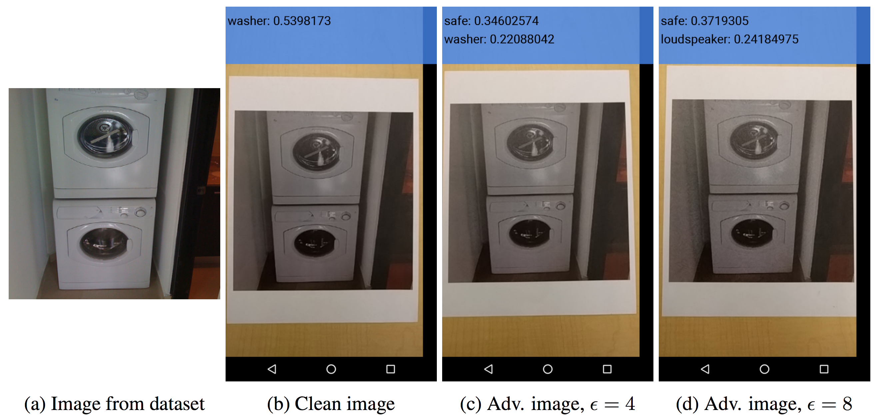
Whitebox (Indirect) [57]

Slide 22
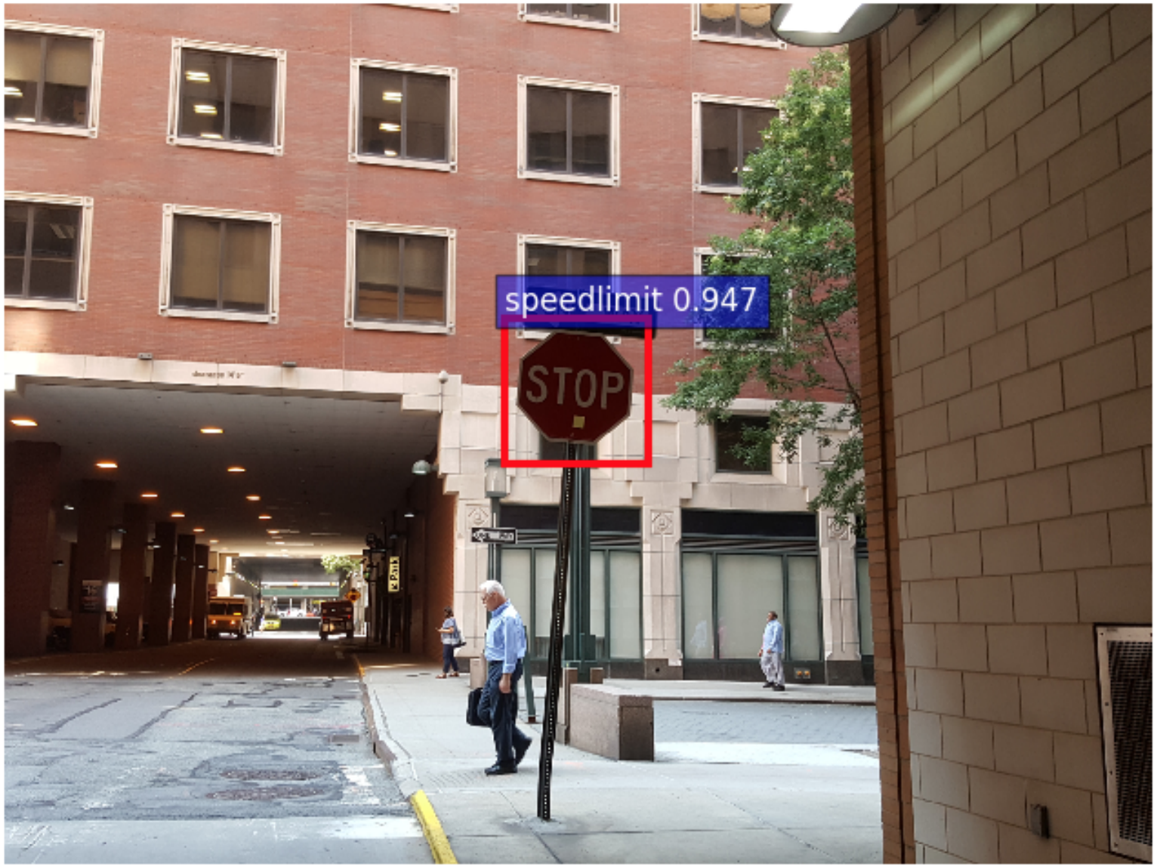
Gu et al. (BadNets)

Slide 23
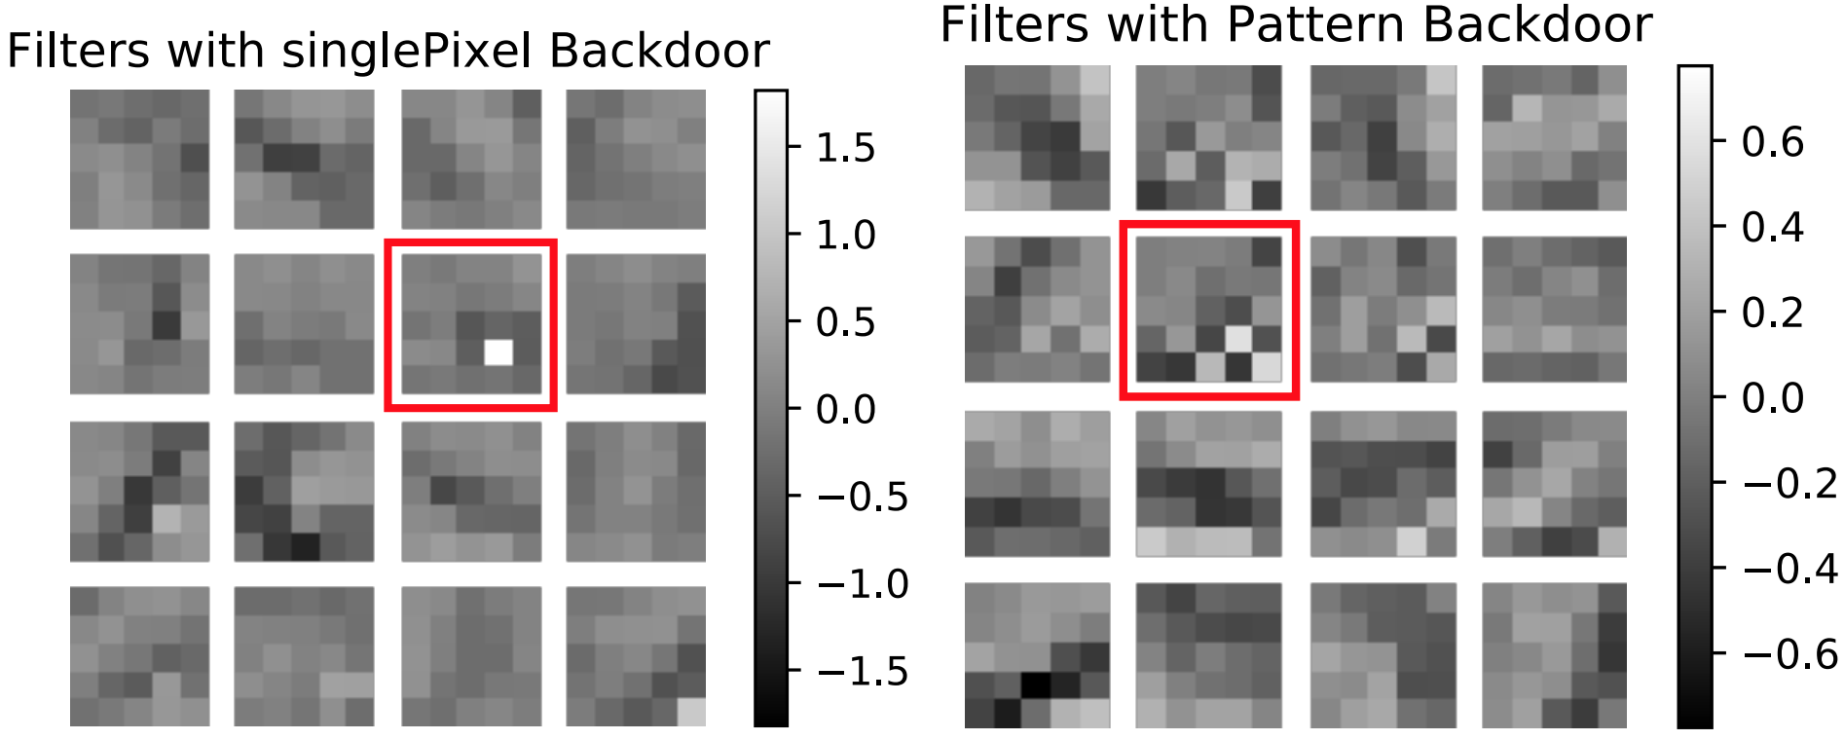
Gu et al. (BadNets)

Slide 24
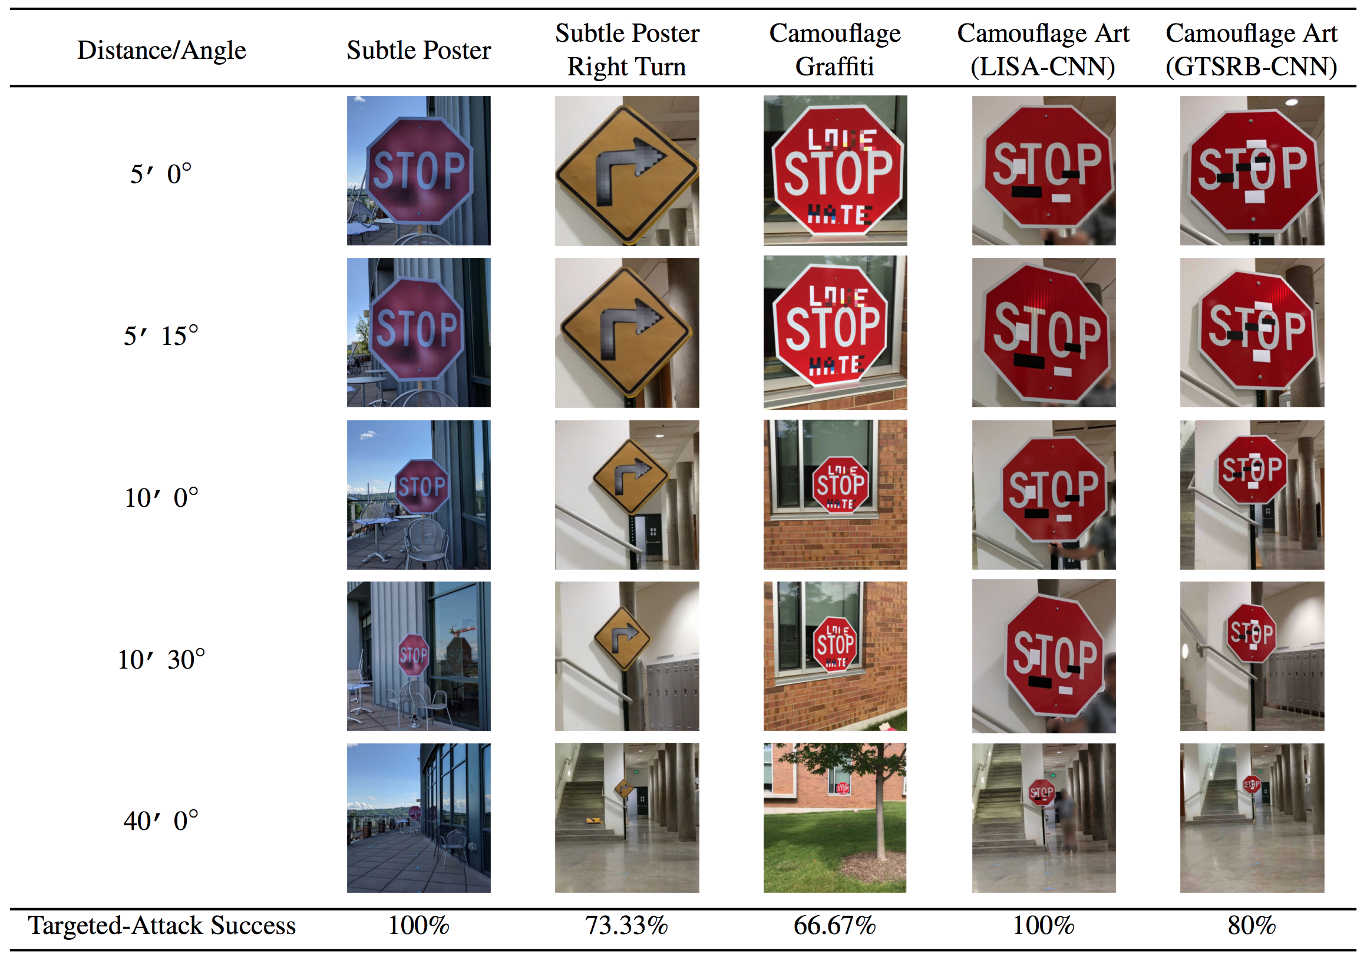
Eykholt et al. (2018)

Slide 25
cleverhans
Collection of adversarial example generation
DNN-focused
Some techniques could be adapted to other classification scenarios

Slide 26
Run mnist_example Attack
Post the test accuracies reported to group chat. Hint: set nb_epochs=1 if you TensorFlow does not detect GPUs.

Slide 27
Select the most true choice below
Polling Question
a.) Blackbox attacks are easier to perform and require a less sophisticated attacker than whitebox attacks
b.) Whitebox attacks are easier to perform and require a less sophisticated attacker than blackbox attacks
c.) Blackbox attacks are easier to perform but require a more sophisticated attacker than whitebox attacks
d.) Whitebox attacks are easier to perform but require a more sophisticated attacker than blackbox attacks
e.) Whitebox and blackbox attacks are equally easy to perform

Slide 28
Select the most true choice below
Polling Question
a.) I would expect to see more blackbox attacks than whitebox attacks in the wild
b.) I would expect to see more whitebox attacks than blackbox attacks in the wild
c.) I would expect to see roughly the same amount of whitebox and blackbox attacks in the wild

Slide 29
Whitebox Defense: JPEG Defense

Slide 30
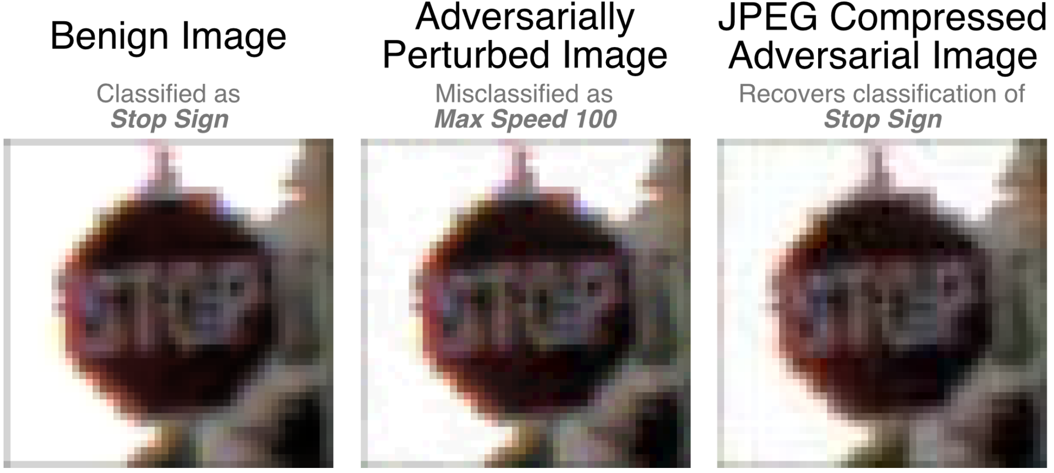
JPEG Defense (Das et al. [2017])

Slide 31
JPEG Defense
Implement JPEG defense w/ MNIST
Recommendations:
Use mnist_tutorial code from cleverhans
tf.image.{decode,encode}_jpeg
tf.image.convert_image_dtype
Try w/ different levels of compression
Post test accuracy & compression quality

Slide 32
JPEG Defense
What was the most “effective” quality level?
What happened when quality was increased?
Worse or better than image example?
Why?
Post to group chat

Slide 33
References
Papernot et al. “SoK: Towards the Science of Security and Privacy in Machine Learning” https://arxiv.org/pdf/1611.03814.pdf (see for [#] citations)
Chen et al. “Practical Attacks Against Graph-based Clustering” https://arxiv.org/pdf/1708.09056.pdf
Meng et al. “MagNet: a Two-Pronged Defense against Adversarial Examples” https://arxiv.org/pdf/1705.09064.pdf
Gu et al. “BadNets: Identifying Vulnerabilities in the Machine Learning Model Supply Chain” https://arxiv.org/pdf/1708.06733.pdf [code]
Das et al. “Keeping the Bad Guys Out: Protecting and Vaccinating Deep Learning with JPEG Compression” https://arxiv.org/pdf/1705.02900.pdf
Eykholt et al. “Robust Physical-World Attacks on Deep Learning Visual Classification” https://arxiv.org/pdf/1707.08945.pdf
Zhang et al. “DolphinAttack: Inaudible Voice Commands” https://arxiv.org/pdf/1708.09537.pdf
Cleverhans (adversarial attack generation methods): https://github.com/tensorflow/cleverhans
More code: https://en.wikipedia.org/wiki/Adversarial_machine_learning#Software

